Slide 1


Bike Share Analysis
Google Data Analytics Capstone Project
By: Ayush Kumar Nayak

Slide 2
Introduction
This is a case study as a part of the Google Data Analytics Professional Certificate course offered by Coursera. I have used Microsoft PowerBI and in-built Power Query to perform my analysis.
Scenario:
Imagine you are a junior data analyst working in the marketing analyst team at Cyclistic, a bike-share company in Chicago. Your team wants to understand how casual riders and annual members use Cyclistic bikes differently. From these insights, your team will design a new marketing strategy to convert casual riders into annual members. But first, Cyclistic executives must approve your recommendations, so they must be backed up with compelling data insights and professional data visualizations.

Slide 3
About the company
In 2016, Cyclistic launched a successful bike-share offering across Chicago. Until now, Cyclistic’s marketing strategy relied on building general awareness and appealing to broad consumer segments. One approach that helped make these things possible was the flexibility of its pricing plans: single-ride passes, full-day passes, and annual memberships. Customers who purchase single-ride or full-day passes are referred to as casual riders. Customers who purchase annual memberships are Cyclistic members. Cyclistic’s finance analysts have concluded that annual members are much more profitable than casual riders. Although the pricing flexibility helps Cyclistic attract more customers, maximizing the number of annual members will be key to future growth. Rather than creating a marketing campaign that targets all-new customers, Design marketing strategies aimed at converting casual riders into annual members. In order to do that, however, the marketing analyst team needs to better understand how annual members and casual riders differ, why casual riders would buy a membership, and how digital media could affect their marketing tactics. Moreno and her team are interested in analyzing the Cyclistic historical bike trip data to identify trends.

Slide 4
Six step approach
ASK
PROCESS
SHARE
1
3
5
2
4
6
PREPARE
ANALYZE
ACT

Slide 5
Phases in analysis:
ACT
ASK
Design marketing strategies aimed at converting casual riders into annual members. The business question: “How do annual members and casual riders use Cyclistic bikes differently?”
As per the analysis, several recommendations are suggested and insights have been derived. Acting on the same is expected to solve the business question.
SHARE
PREPARE
The dashboard along with a executive summary with recommendations is shared in the drive link.
12 months of CSV files organized from January to December, 2021. Data follows ROCCC so it is suitable for analysis.
ANALYZE
PROCESS
Now, that the data is cleaned and aggregated, it is time to find insights through visuals. Several visualizations used in the dashboard.
Power Query + Power Pivot used to Extract, Transform and Load (ETL). Getting data into Power BI by uploading the folder combining files of all of the 12 months data

Slide 6
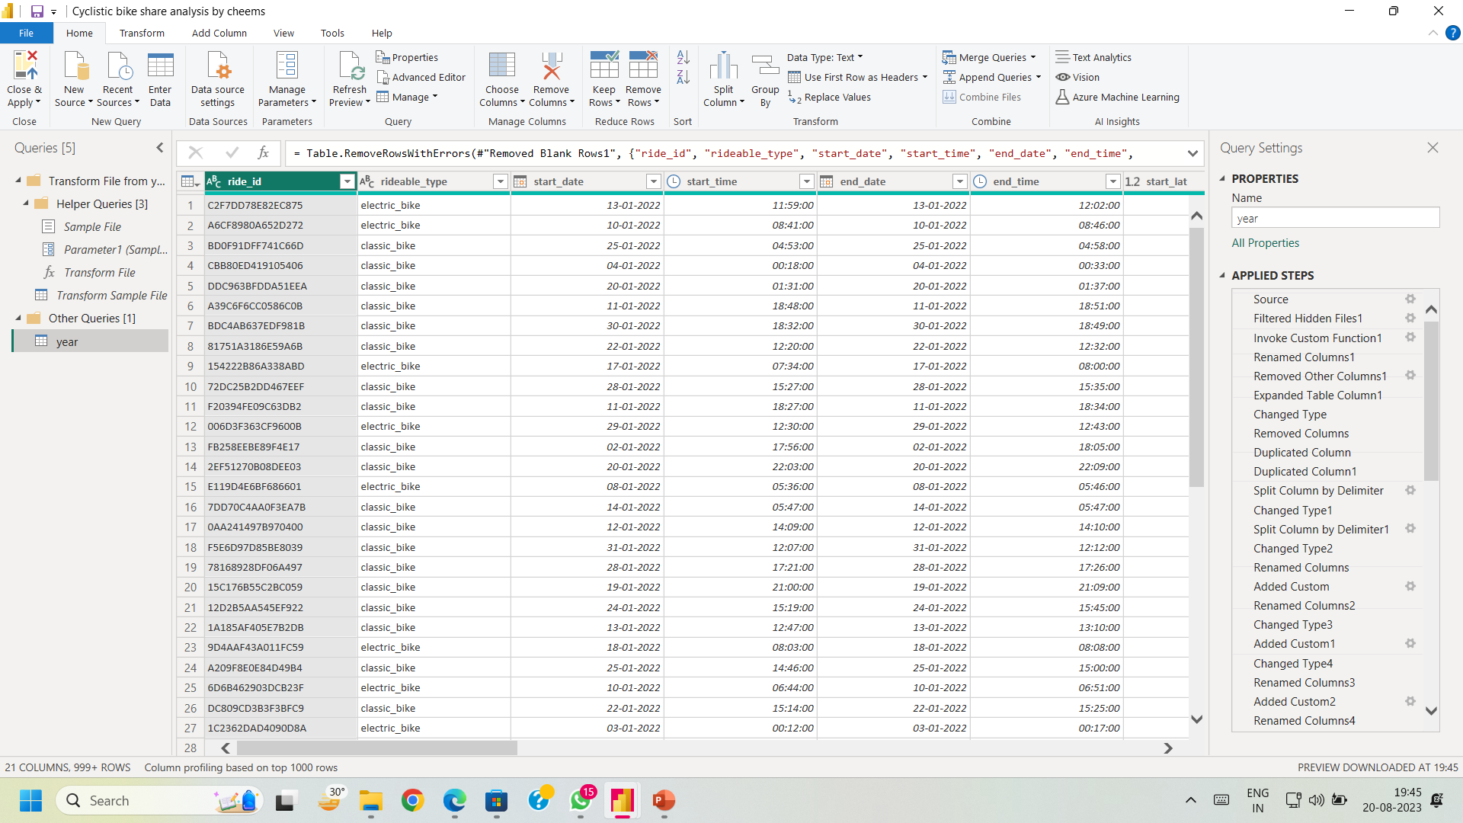
Extract, Transform and Load (ETL) :
The 12 months data was combined into one folder and extracted in PowerBI.
Data cleansing and transformation was performed in Power Query along creation of measures using DAX expressions.
The combined data was then loaded in PowerBI. Next a dashboard was created to gain useful insights

Slide 7
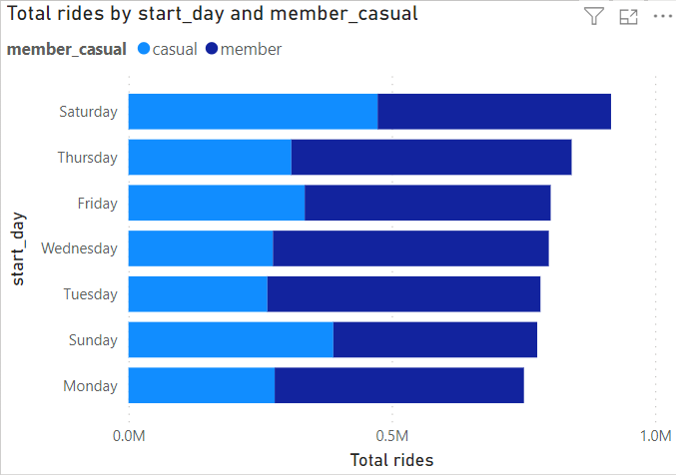
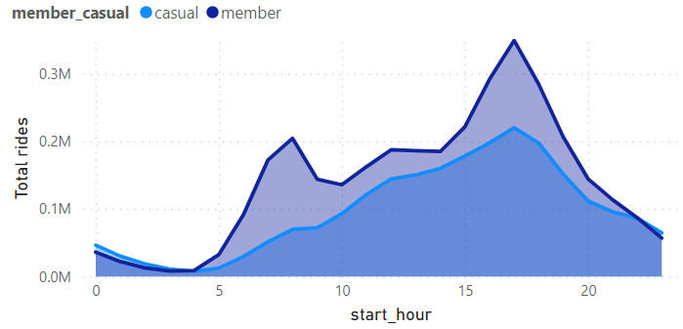
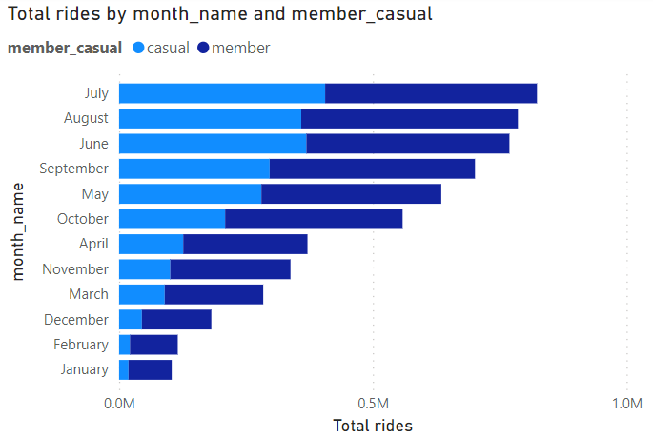
Analyzing the data:
From the graphs above, it is evident that casual members prefer riding bikes in late summer months of July, August and June but rides is decreasing drastically in the winter months most likely due to the weather conditions in Chicago. It can be observed that there is more riding happening on the weekends (Thursday, Friday, Saturday). Properly most casual riders ride for leisure during the weekends including Friday Saturday and Sunday. Member riders are using it in a more steady manner that is the variation in ridership is not very large as compared to casual riders. Also, ridership especially in members basically has two peaks. One around 8 in the morning another at 5 in evening. In a contrast, casual riders are quite small in the morning and the ridership peaks only in the evening at around 5. It shows that members use the bikes for going to work as well whereas casual ridership is mostly for leisure. More such insights can be derived from the dashboard.

Slide 8
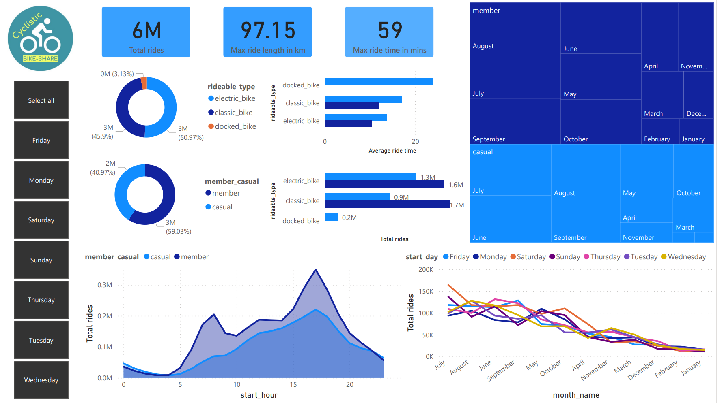
Dashboard:

Slide 9
Conclusion and recommendations:
Conclusion:
Member riders are more in population then casual riders but Average time per minute for bike use by casual riders is greater then member riders.
Casual Riders use mostly bikes then member riders in late summer while in all other months of year member riders use mostly bikes. Member riders use rides between 0.4M to 0.5M in all days of week ,casual riders use its mostly bike on weekend between 0.38M to Member riders use bikes mostly in the evening followed by a short peak in the morning. Casual riders use mostly bikes between12PM to 8PM.
Besides all these facts we can conclude that Member riders use bikes for daily routine or they might use it for 9 to 5 job while casual riders use it for enjoinment specially in evenings ,weekends and in summer peak days.
Recommendations:
Management should implement strategies to improve the use of other bike types such docked and electric bikes. Campaigns should not target converting causal riders to members, but also the need to increase the used of all bikes. Docked bikes are the least used bikes but have a larger ride time and are used by casual members only. So, a specific strategy for promotion of docked bikes is suggested.
As casual riders turn to ride frequently in late summer, the campaign must be intensified during this period. This would enhance well target campaign with the potential of high conversions.
Weekends and evenings are busy as (casual) riders probably use bikes for leisure purposes, targeting them on the weekend would be a great advantage to convert them into members.
In most cases casual members have a higher ride time and higher ride length, a yearly subscription of evening(12PM to 8PM ), weekend days(friday,saturday,sunday) and summer holiday months will clearly provide us a higher revenue.
Benefits of the membership subscription should be given to casual members as some casual riders might not be aware of the benefits associated with the monthly subscription package.

